Slide 1
Statistics and Distributions
Eric Prebys
Phy 40
Fall 2025

Slide 2
Probabilities
At the microscopic level, everything in physics is governed by probabilities.
When statistics become large enough, the uncertainties become small enough that probable outcomes become virtual certainties
This is how casinos make money!
In this course, we will analyze some of the statistical properties most often encountered in physics.

Slide 3
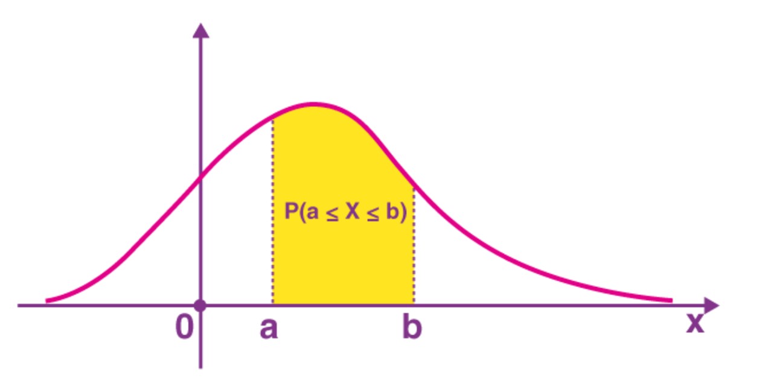
Probability Distributions
In general, we can characterize a probability by a “Probability Distribution Density Function” (PDF). In one dimension, this is defined as
Probability of being between x and x+dx
Probability of being between a and b is
Normalization:

Slide 4
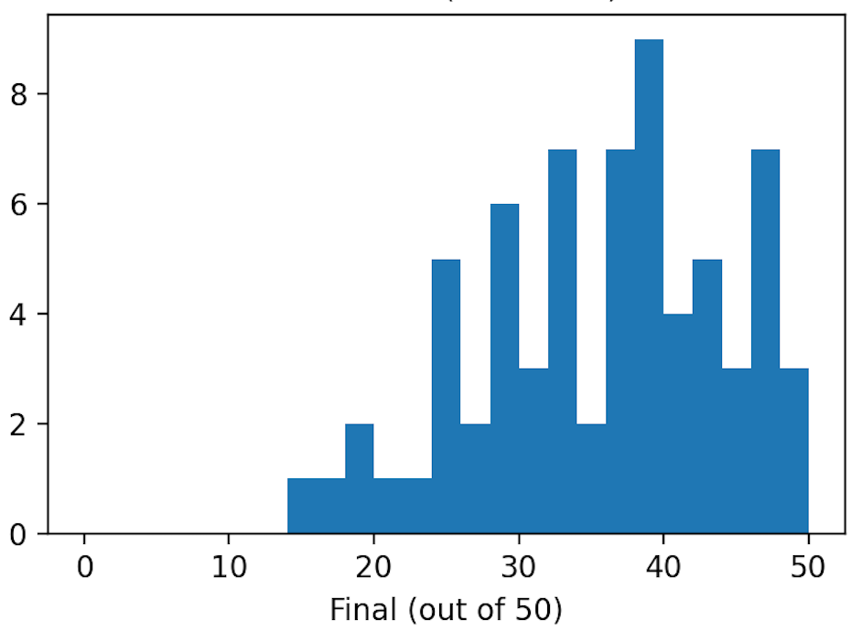
Histograms
We generally plot distributions using “histograms”, which record the number of entries falling within particular ranges.
Example: score on Phy 009D final exam

Slide 5
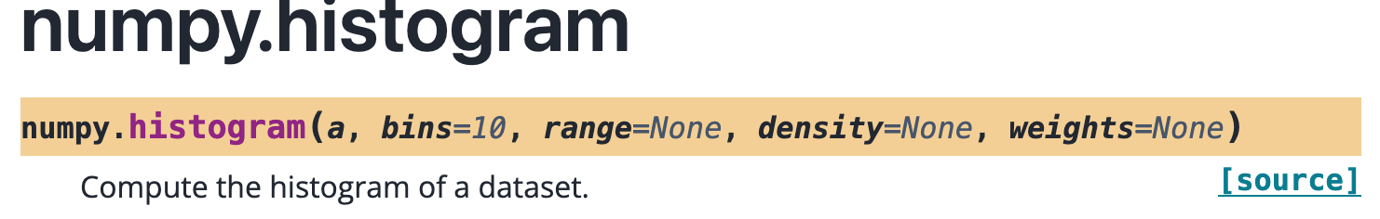
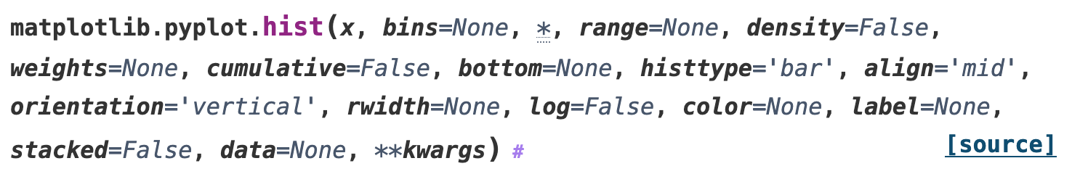
Histogramming Tools in Python
Python has two basic tools for histogramming
bins can either be a number of (equal) bins or a list of bin edges, which can have unequal width.
Returns the bin contents and the bin edges
Note: an N bin histogram will have N+1 edges
Have to use another tool to plot the histogram
Calls numpy.histogram and then plots the histogram
Generally can use the latter unless:
You want to process the data in some way before plotting it
You want to plot a histogram with error bars!

Slide 6
Random Numbers in Python
The numpy.random package contains a powerful set of routines to generate random numbers, including
Uniform random numbers in a specified range
Distributions based on user-specified probabilities
Normal (Gaussian) distributions
Binomial distributions (we’ll discuss this shortly)
Many, many, more
Without a physical inputs, computers cannot generate truly random numbers. They generate “pseudo-random” numbers, based on a starting ”seed”.
If unspecified, they usually use the unique time as the seed.
If a seed is specified (np.seed(int)), then identical subsequent random number calls will produce identical numbers each time
This can be very important for debugging code!
Do uniform and Gaussian demo…

Slide 7
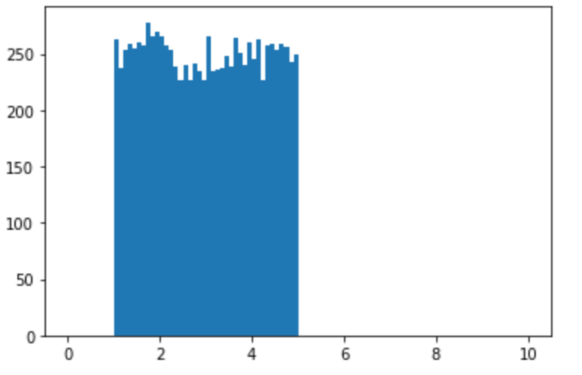
Uniform Probability
A uniform probability is a distribution within a specified range in which every value in the range has an equal probability.
Example: a uniform distribution from 1 to 5

Slide 8
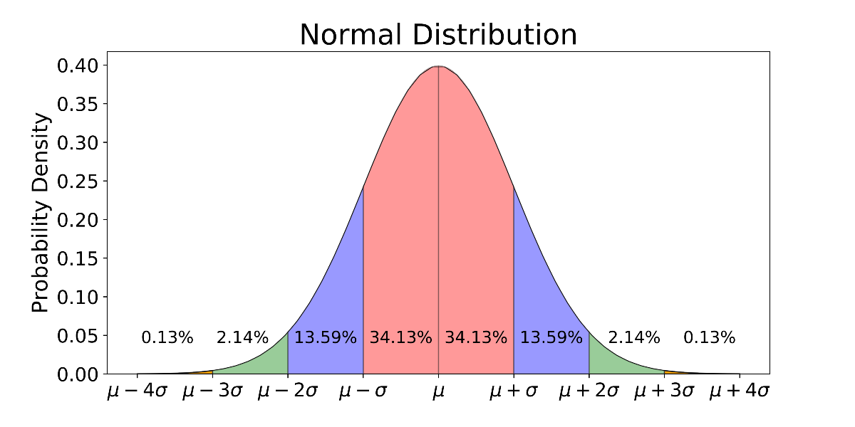
Normal Distribution
A normal (or “Gaussian”) distribution is a probability characterized by a mean (μ) and a standard deviation (σ), according to the following PDF
As we will see, in some limit, all errors can be characterized by this distribution (“central value theorem”)

Slide 9
Binomial Distributions
Let’s imagine I flip a coin 10 times, and it comes up heads 4.
If I look at the first heads, there are 10 possibilities for which throw it came from, 9 for the second, 8, for the third, and 7 for the fourth, for a total of possibilities
But I don’t actually care which throw each came for, so for the first heads there are 4 possibilities that are identical, 3 for the second, the for a total of 4! Indistinguishable “permutations”, so the total number of cases with 4 heads is
Generalizing this, the number of times, we get n_{H} out of N throws is given by
“Binomial coefficient”

Slide 10
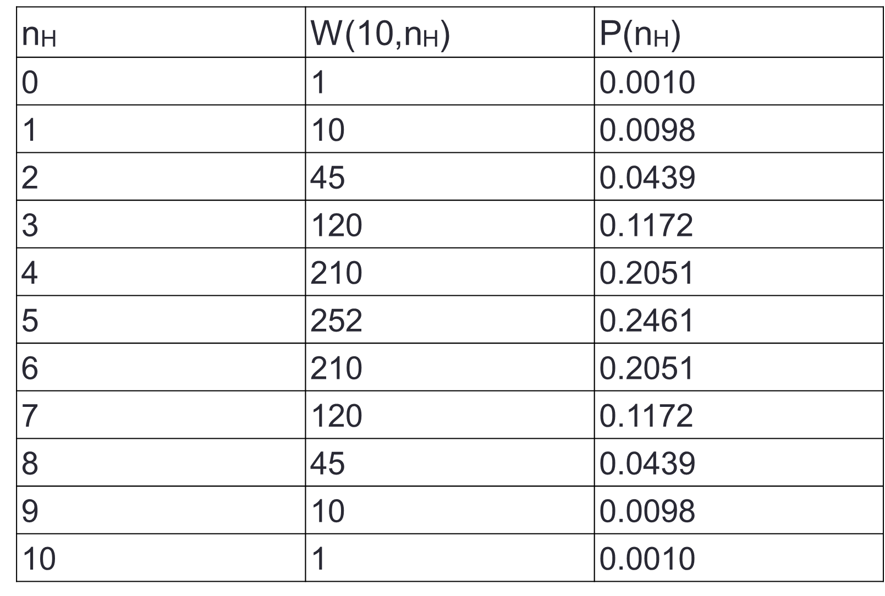
Probabilities
If I flip a coin N times, there are 2^{N} possible unique sequences, so the probability of finding n_{H} after N throws is
For 10 throws, there are 2¹⁰=1024 possible combinations, so the table of probabilities is

Slide 11
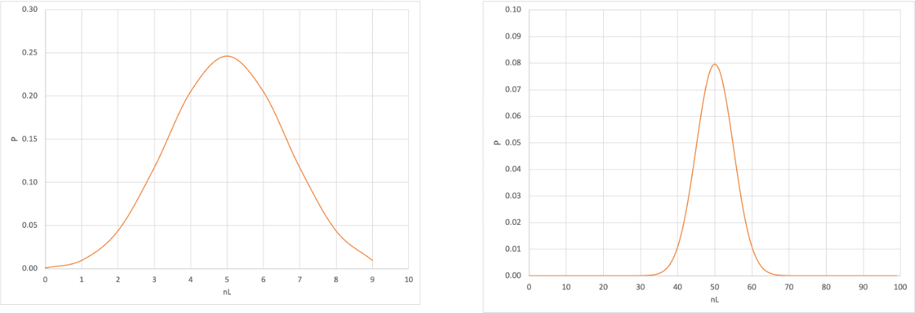
Going to More Throws…
The more throws, the narrower the distribution becomes
Of course, the number of particles in a box is much bigger than 100, so the fraction on the left will be very close to ½ , but will have a distribution.
10 Throws
100 Throws

Slide 12
Generalized Binomial Distribution
In our example, a coin had an equal probability (50%) of coming up heads or tails.
If instead we have two distinct outcomes, A and B, in which the probability of A is p, the probability of B is therefore (1-p), and the normalized binomial distribution is modified as follows
The probability of n_{A} outcomes in state A out of N total trials is
The average value over many trials of N “throws” will be
And the RMS of the distribution will be
Relative width gets narrower

Slide 13
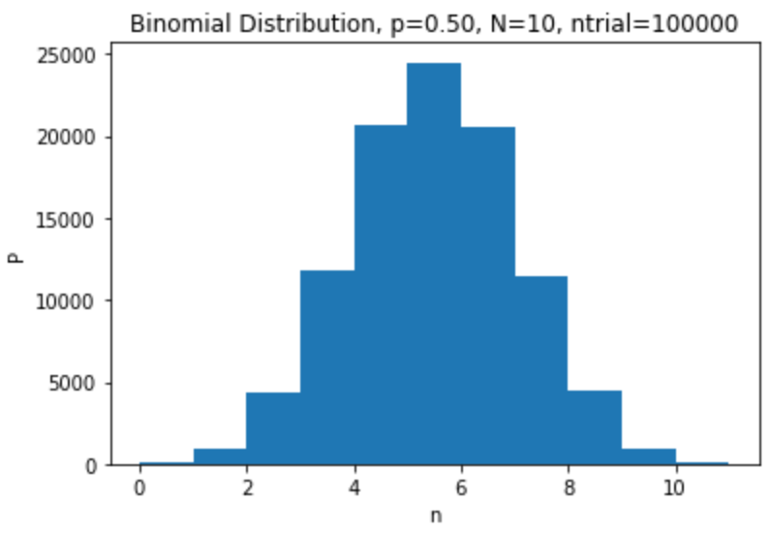
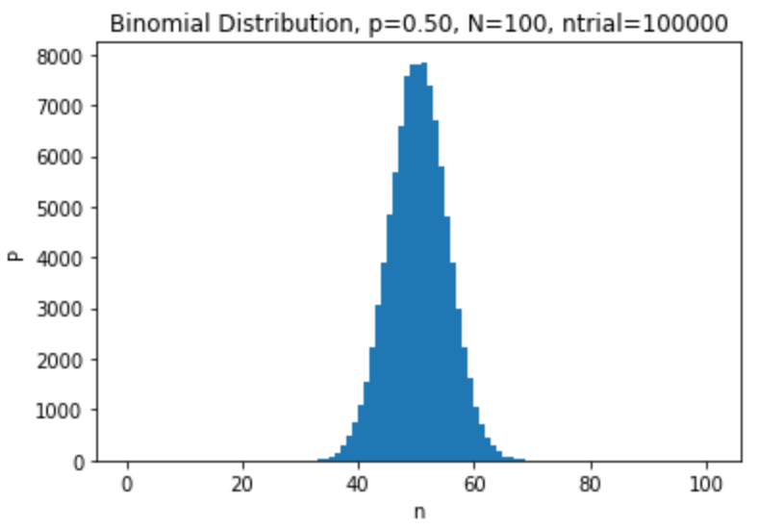
Simulating Binomial Distributions in Python
We will simulate binomial distributions with
numpy.random.binomial(N,p,Ntrial)
For a coin, p=1/2
Number of times I repeat the test. If 1 (or missing), it returns a scalar, otherwise it returns a vector
Number of “throws”
Probability each throw

Slide 14
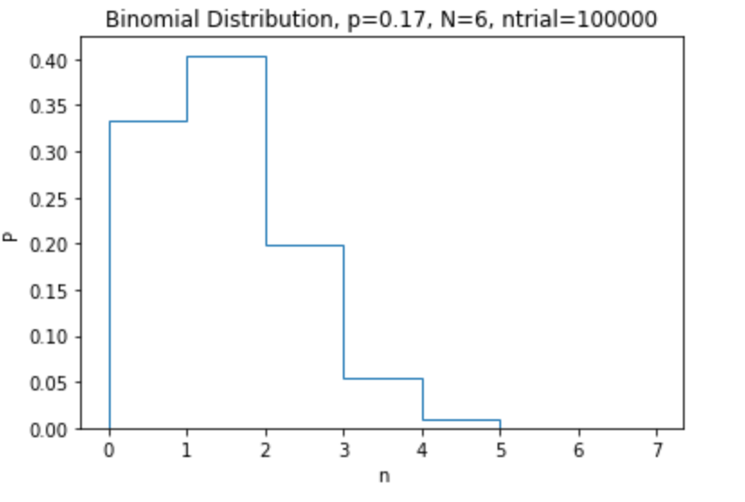
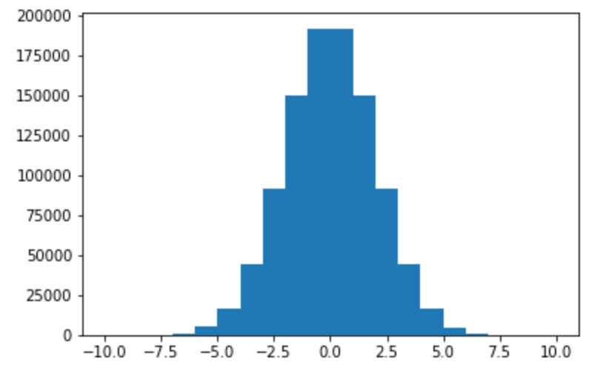
Location of the Bin
In most of the examples we’ve done, we’ve been histogramming integers into unit bins, so the location of our entries is always the left side of the bin, which we get with bins[:-1] (the last entry in bins is the final right location)
On the other hand, the normal distribution is a continuous variable, in which the values are distributed ~uniformly over the bin.
Makes more sense to put the location in the center of the bin.

Slide 15
Fitting to Functions
The number of entries in a particular bin of a histogram is given by integrating the PDF over the width of the bin.
We can generally approximate this by multiplying the central value times the bin width
This is another good argument for using the center of the bin, which is weirdly done with the “align=‘left’” option.
x_{i,left}
x_{i,mid}
x_{i,right}

Slide 16
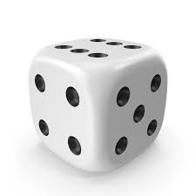
Die Example…
If p is the probability of an event occurring, then the expected number of events for N “throws” is
But what if λ<1?
Example: throwing a 6-sided die three times
The chance of it coming of any particular number, say 4, is 1/6, so the average number of will come up 6 in 3 throw is
Of course, it can’t come up .5 times, it can only come up 0,1,2, or 3 times.

Slide 17
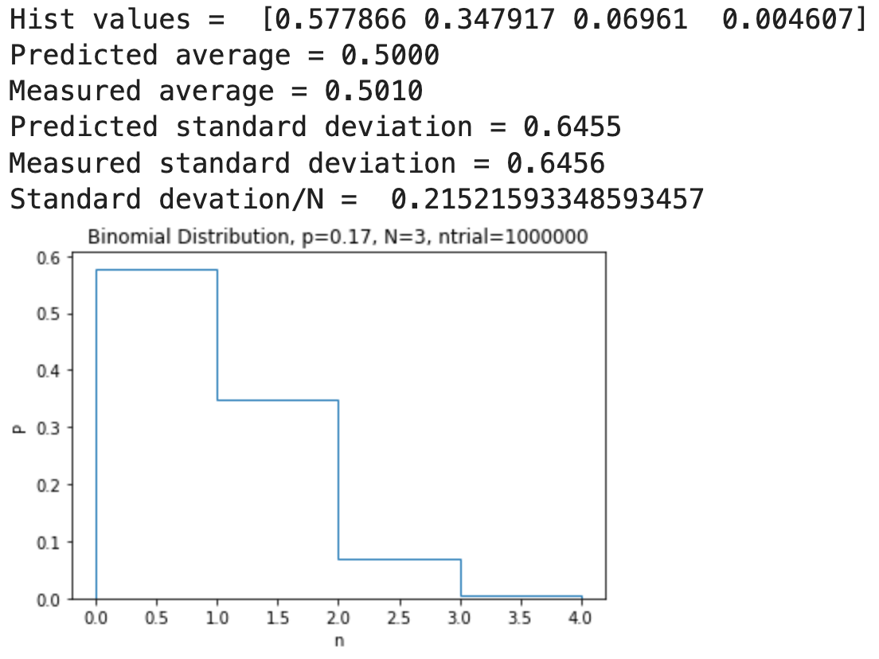
Binomial Distribution for Die Throws
In this case, our options are coming up 4 (p=1/6) or coming up any other number (q=(1-p)=5/6)
The binomial theorem tells is that the probability of coming with 4 a particular number of times is given by

Slide 18
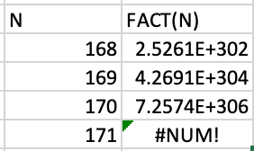
Approximations
The binomial expression is exact, but factorials get problematic pretty fast
Generally, we use two approximations, depending on the expectation values on the counts
“Small statistics” (λ<10): Poisson statistics
Example: throwing a die 3 times
“Large statistics” (λ≥10): Gaussian statistics
Example: flipping a coin at least 10 times
170! is the biggest number that can fit in a 64-bit floating point, and we deal with numbers in the millions, billions, or more

Slide 19
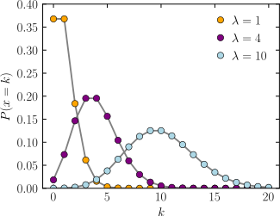
Poisson Distribution
Probability Mass Function
For small statistics (λ<10), the PMF can be approximated by
This equation will also continue to work, but again, these terms will quickly become problematic for large λ
Note the equation becomes symmetric for a λ of 10 or more

Slide 20
Gaussian Distribution
For larger values of l, we can approximate things with a gaussian distribution.

Slide 21
Generating These Distributions Functions in Python
We will use the scipy.stats package
Poisson distribution
scipy.stats.poisson.pmf(k,lam)
PMF designed for discrete integer points
Gaussian (normal) distribution
scipy.stats.norm.pdf(x,loc=mean,scale=sigma)
PDF is a continuous function
strictly speaking, we should integrate it over each integer value, but we usually won’t do that
“probability mass function”
Point or array of points
λ
“probability density function”
λ
σ
Point or array of points

Slide 22
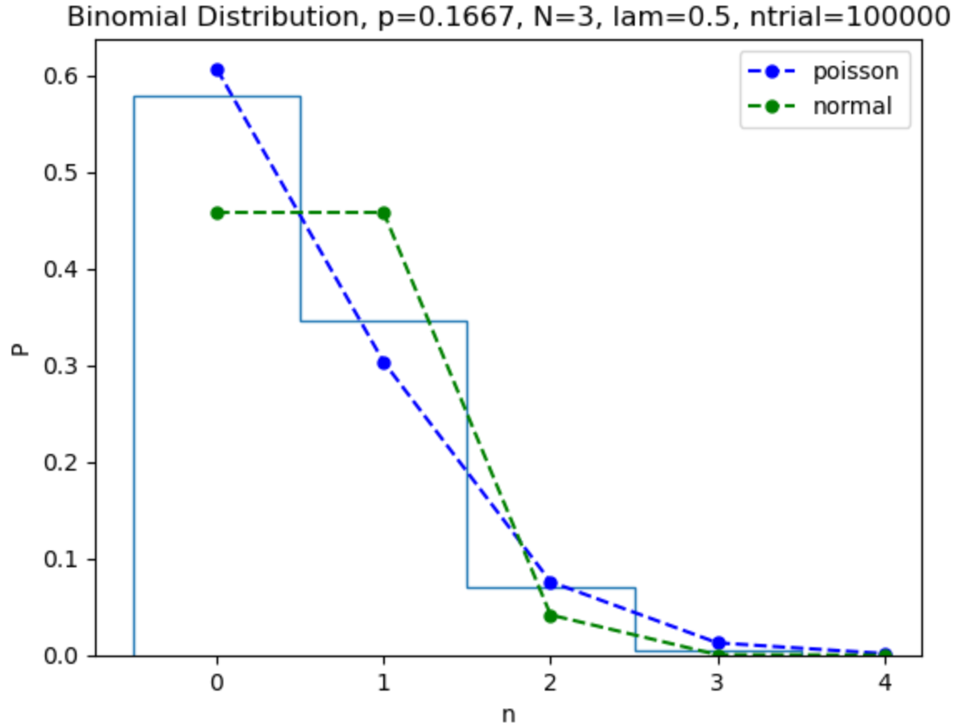
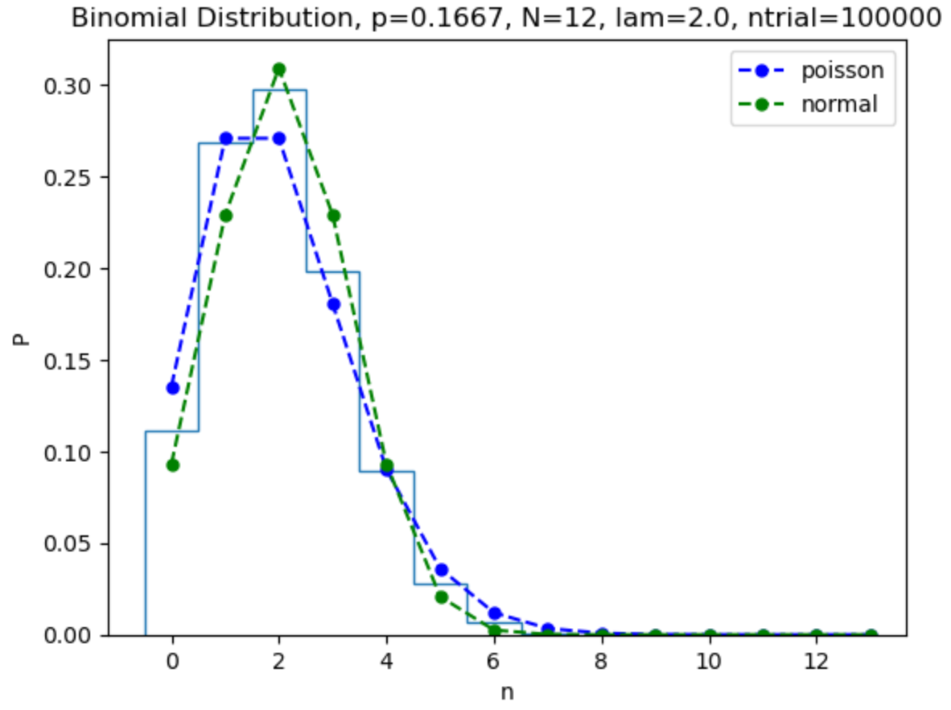
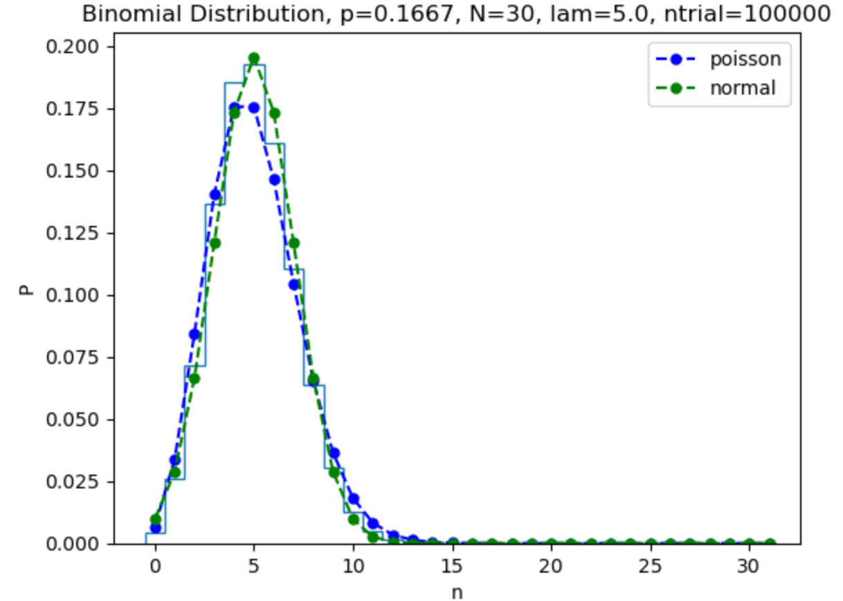
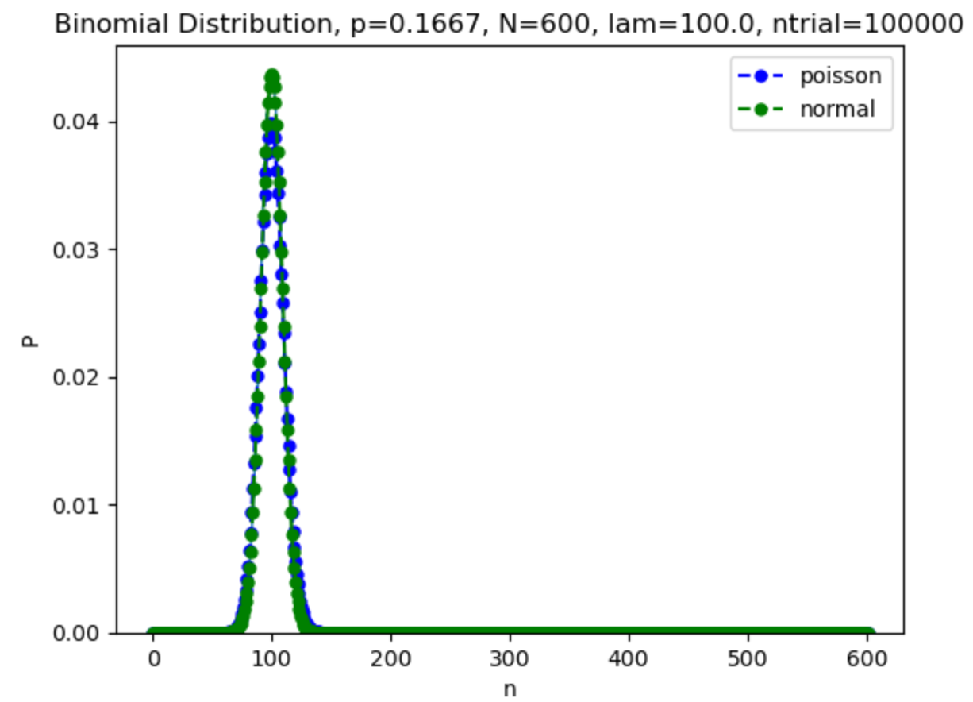
Back to Dice
“Central Limit Theorem” = “Everything eventually becomes Gaussian”

Slide 23
Cumulative Density (or Mass) Functions
For any probability distribution, we can define the ``Cumulative Density function as the integral up to a particular value.
So we can get the probability of falling between any two points as

Slide 24
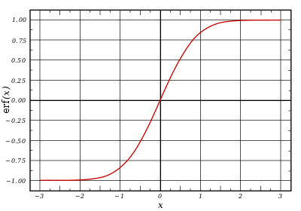
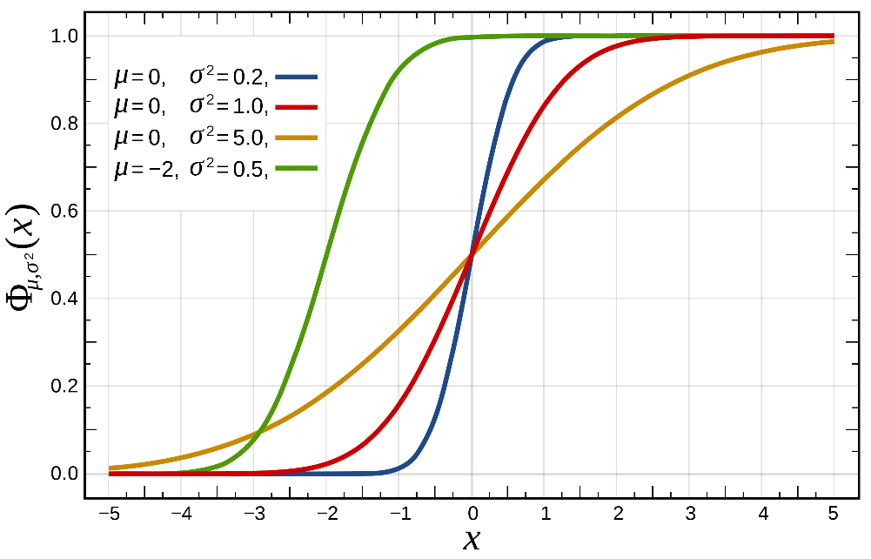
CDF for a Gaussian
Unfortunately, the indefinite integral of a Gaussian is not defined, so we define it in terms of the “error function” (erf())

Slide 25
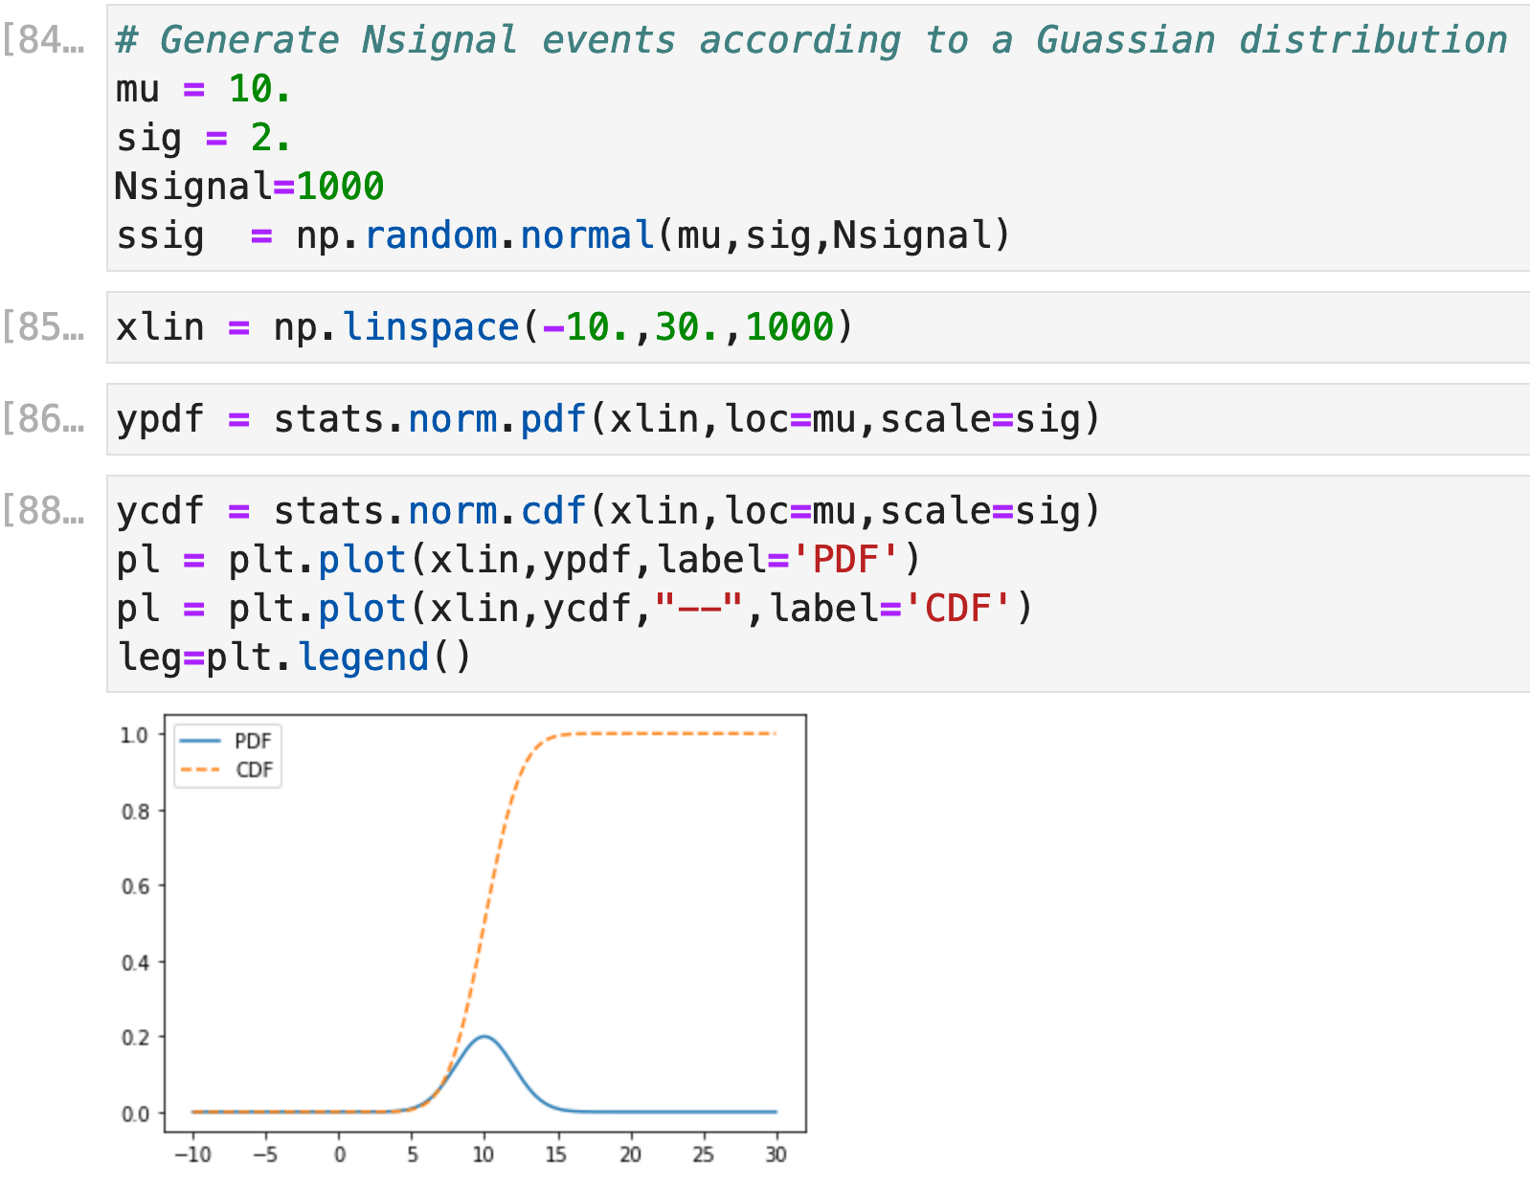
Gaussian CDF in Python
In Python, the CDF is extracted through the cdf method of stats.norm

Slide 26
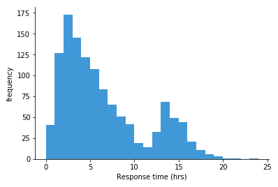
Error on Histogram Bin Contents
If entries are distributed over many histogram bins, we can look at any single bin and consider the binary choice between that bin an all other bins.
Probability that an event will land in bin i.
If there are N events total, then the expected number of events in each bin will be λ_{i}=p_{i}N.
The RMS of the number will be
If there are many bins, then p<<1 and
Number of events observed in bin i.

Slide 27
Limit of Small Statistics
We generally set the error on the contents of a bin as the square root on the number of the events observed in the bin.
This isn’t really accurate when the number of events in the bin is small (say <5).
In particular, if there are no events in the bin, this would say
This will cause any fit to fail if it can’t go exactly through the point.
If we have a small number of bins with zero, we typically set the error to 1.
If there are a significant number of bins with zero, we need to use a different approach to fitting.
No error on point!

Slide 28
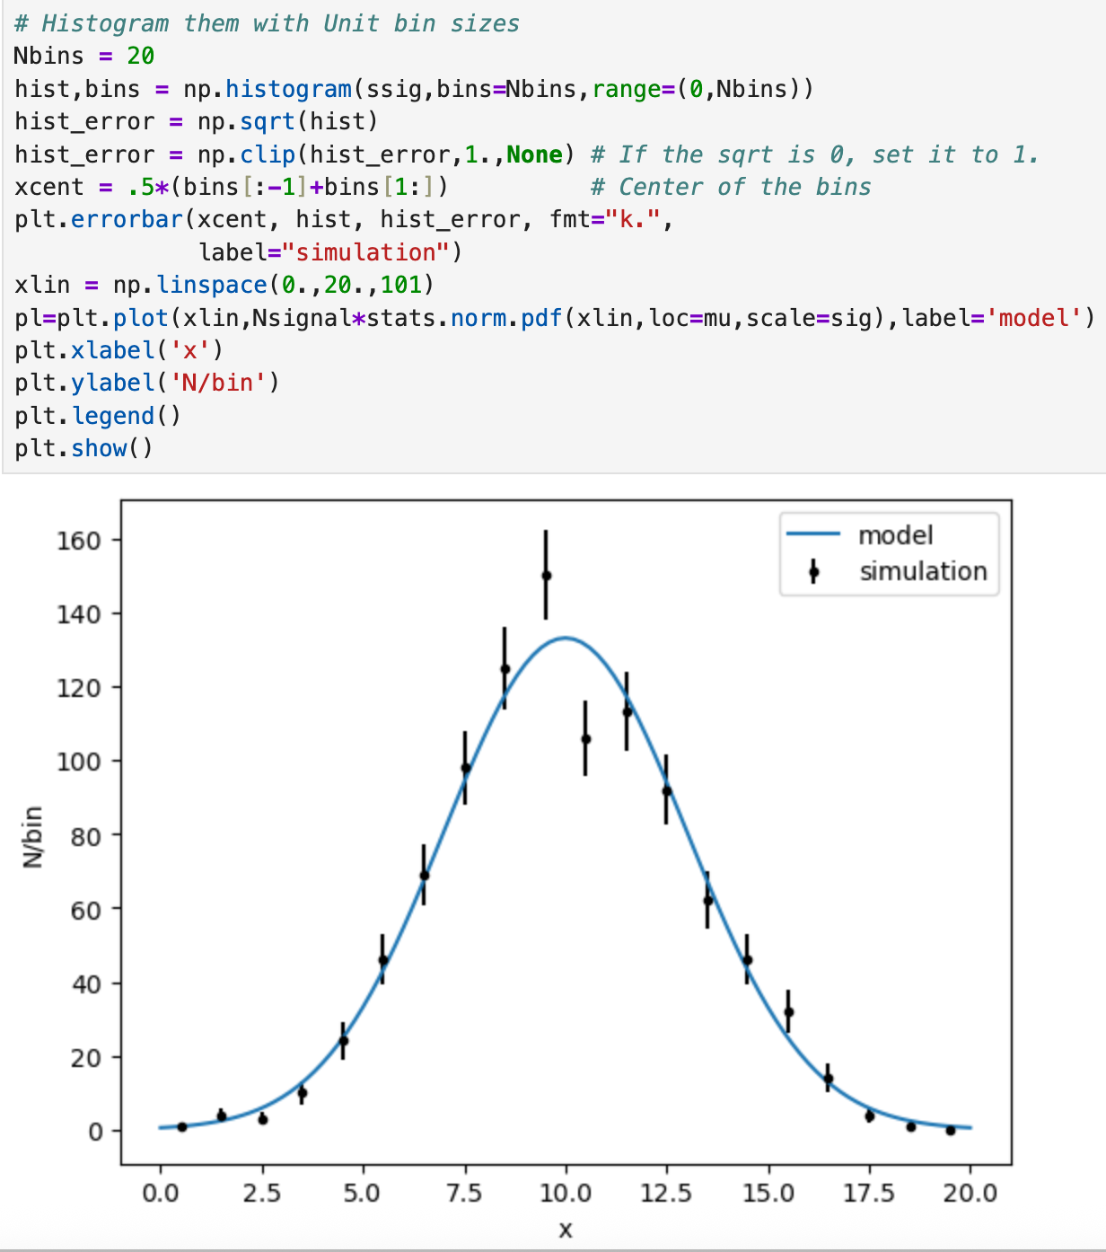
Plotting with Errors

Slide 29
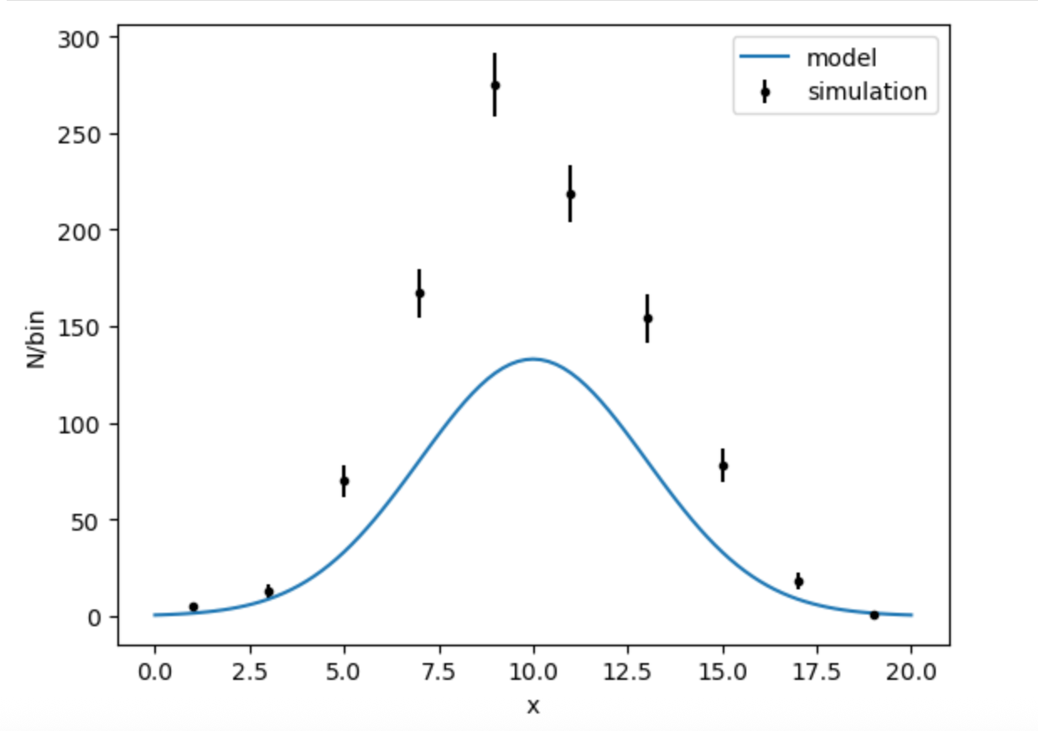
Normalizing Histograms (Important Concept!)
In case you haven’t noticed, in most of our examples, we’ve always made our bin size 1. What happens if we change that. Let’s redo the last histogram with a bin size of 2
What happened?
We added pairs of bins together, which doubled their contents, but my physics shouldn’t depend on how I bin things.
How can I present things in a consistent way?

Slide 30
Our PDF is defined by the normalization condition
The probability of something landing in a particular bin is
If I divide the bin contents (and the error!) by the size of the bin, I should get a result that’s independent of bin size.
Average value over the bin

Slide 31
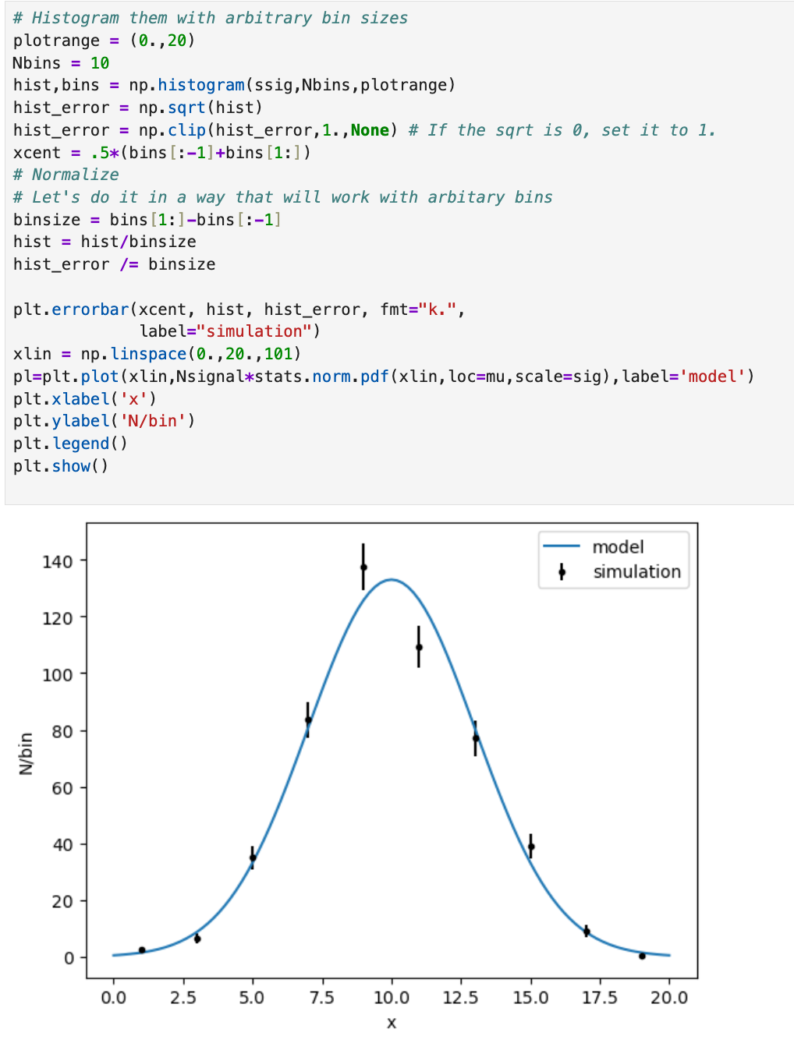
Check

Slide 32
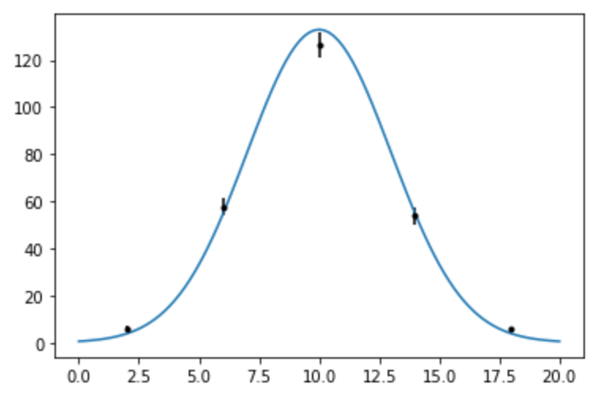
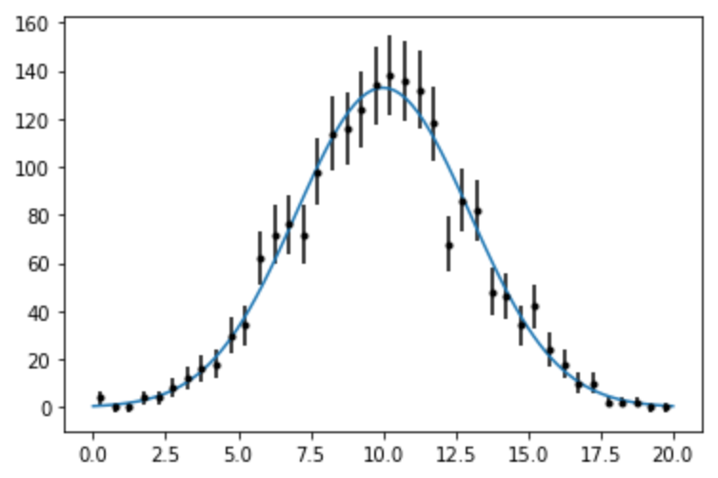
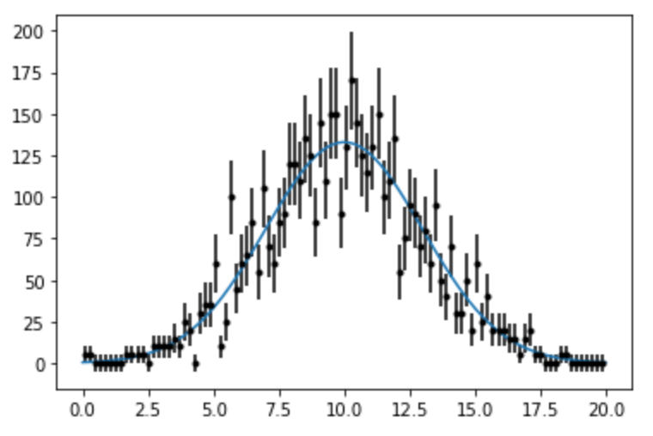
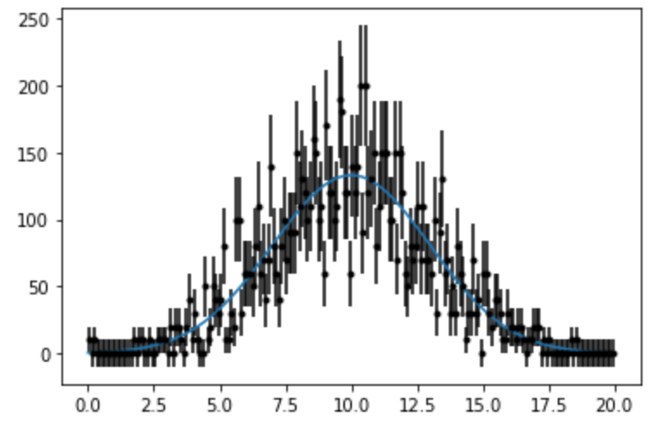
Other Binnings
5
40
100
200

Slide 33
Arbitrary Distributions
In many cases, we want to generate a distribution based on an arbitrary parametrization.
Example, simulating background to a physics signal
In this case, we can use a “Monte Carlo” technique to simulate any distribution

Slide 34
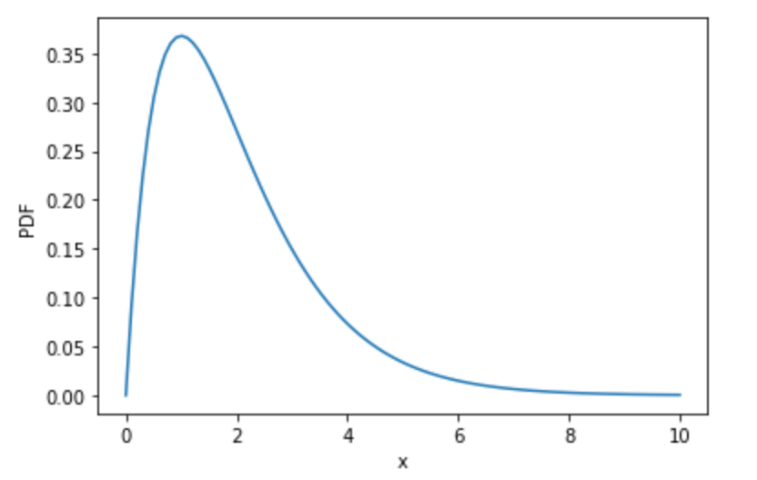
Procedure
max
Example:
Step 0: Choose a range for your random numbers
Step 1: Generate a random value of x which is uniformly distributed over the range.
Step 2: Evaluate the PDF at this point
Step 3: Is the PDF value at this point greater than a random number between 0 and that maximum value of the function?
Yes? Return the value of x
No? Go back to step 1
range

Slide 35
Example
Generate random numbers with a distribution
It looks like a range of 0 to 10 is reasonable, so let’s code this up…
Already normalized.

Slide 36
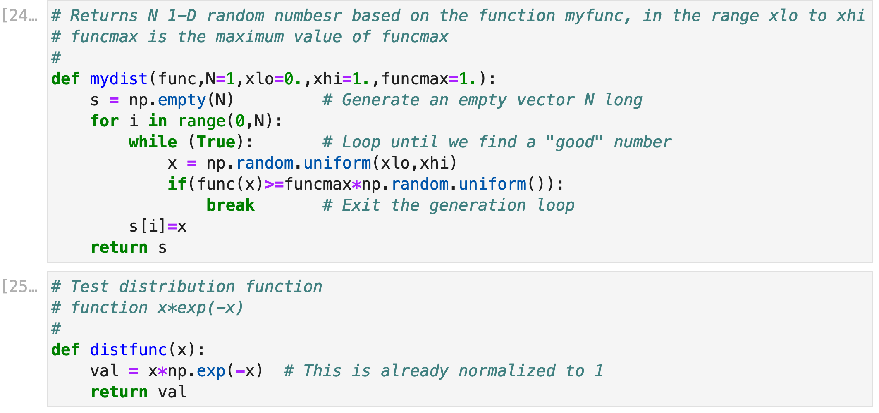
Example Functions

Slide 37
